Slide 1


AFL 2023 Player Performance
Michael Le

Slide 2
Purpose
The goal for this project is to evaluate player performance evaluation and predicting fantasy points, during the 2023 season. There are 808 players in total currently playing, the list of data include such as Player name, Fantasy Points, Rating Points, Goals, Kicks, Marks, Tackles etc. By analysing performance data, analysts can identify strengths and weaknesses. This can enable coaches to pick up new strategies in future matches. To make informed decisions on player selection, match strategies and training focus areas based on data insights. Allowing further prevention when it comes to injuries and manage recovery plans accordingly. Making easier process to identify potential talent when drafting new players or making trades.

Slide 3
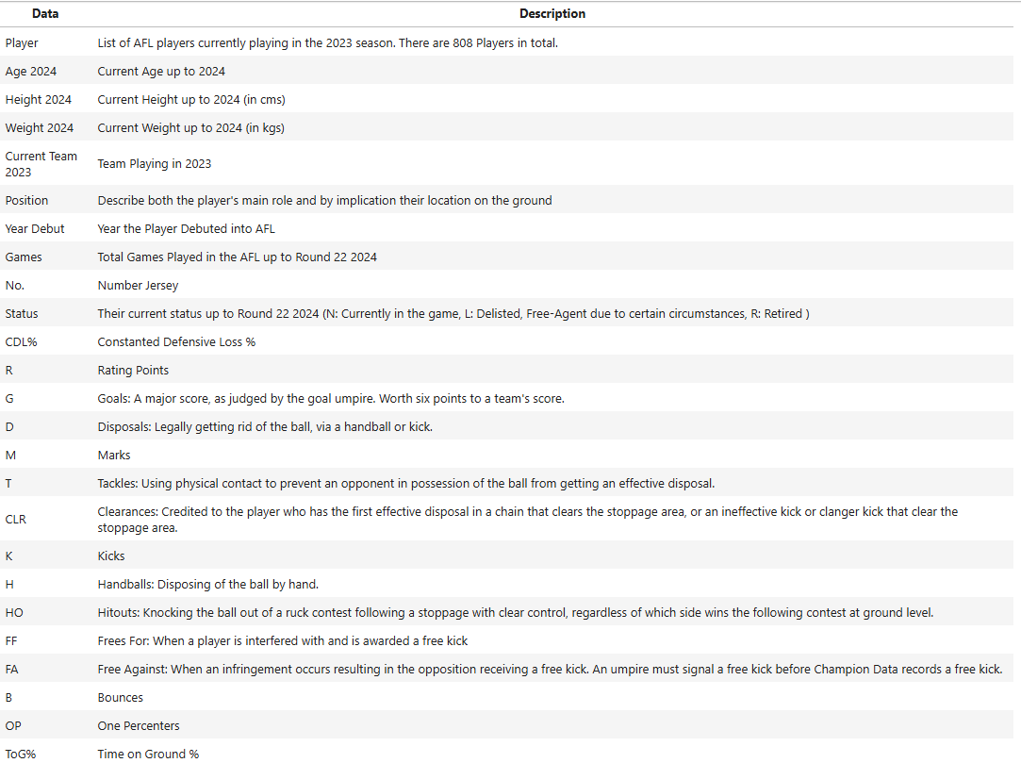
Data Collection
We will often refer to the data information for future analysis.

Slide 4
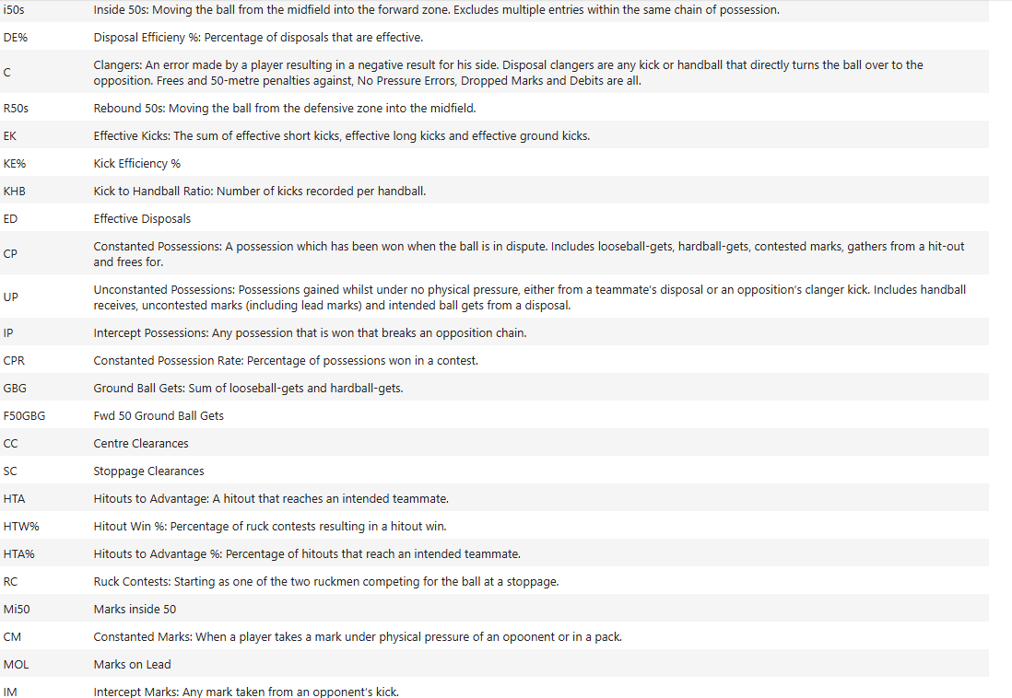
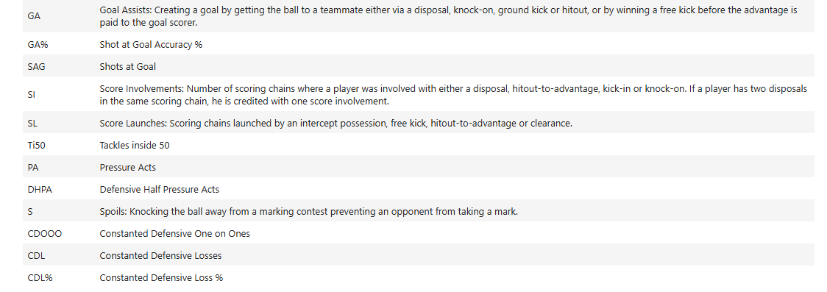

Slide 5
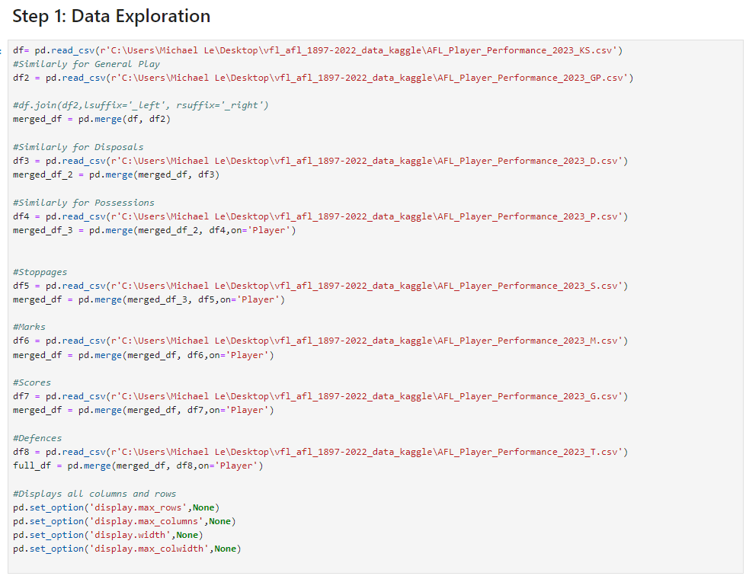
Procedure
The procedure to start the analysis, I have use technologies such as Python one of the programming languages used to performing analysis. This enables me to use library packages, such as pandas, numpy, matplotlib.pyplot and seaborn to collect the data to perform data analysis on Player Performance. To achieve this, I have merged all of the eight datasets to include all the columns and data entries for each of the players information without any loss. Where columns such as Age, Heights, Weights, Status, Jersey Number, Team, Position, Year Debut, Number of Games were added.

Slide 6
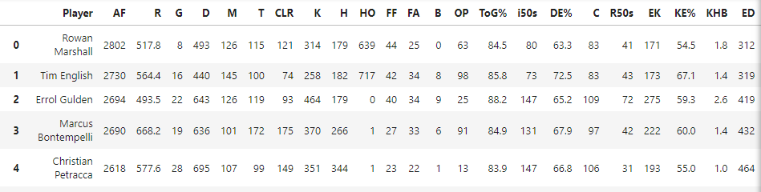
Procedure Part 2
In the next step, we need to clean the data for the player performance dataset. Removing row entries that contain empty or missing data entry and remove duplicate rows and columns. We wanted to re-order the Player column to
easily keep track on the players. After cleaning the data, we check the first 5 entries in our desired final data-frame with 808 rows and 52 columns. To ensure we can provide further exploration, apply feature engineering and visualizations.

Slide 7
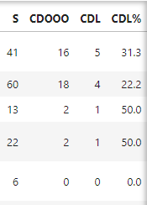
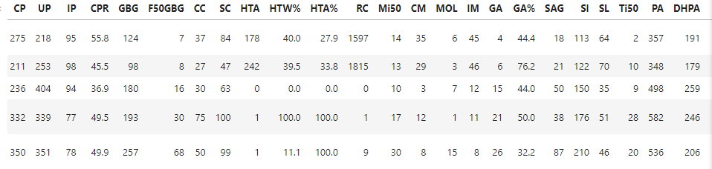

Slide 8
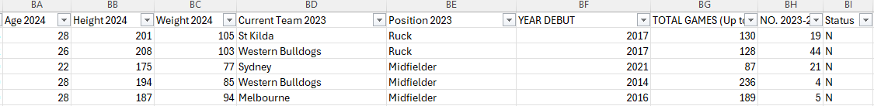

Slide 9
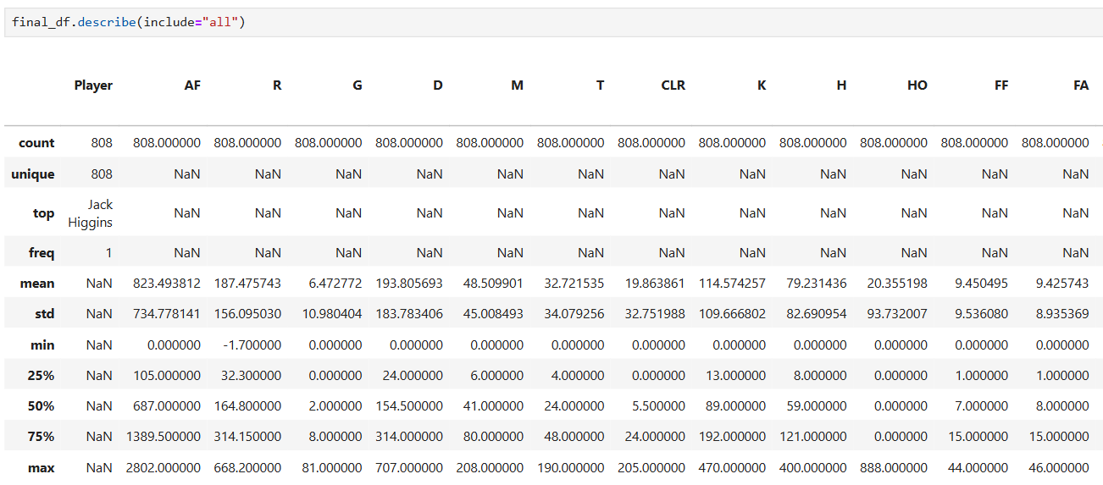
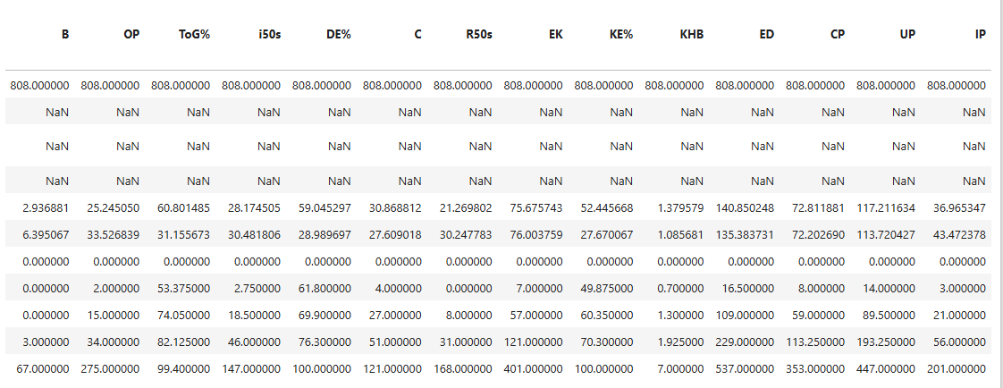
Data Exploration and Analysis
Summary Statistics

Slide 10
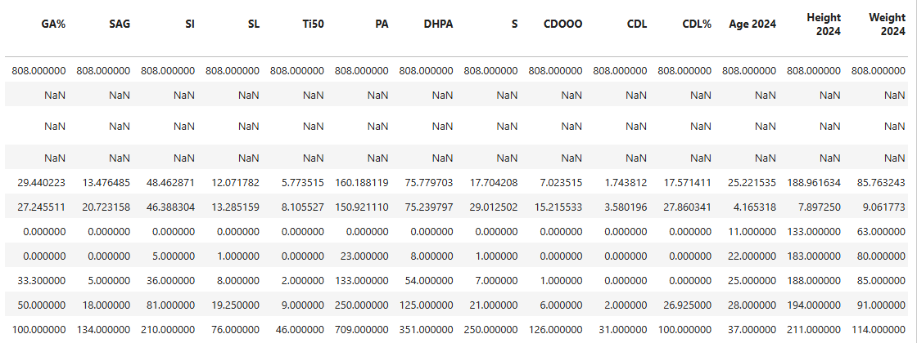
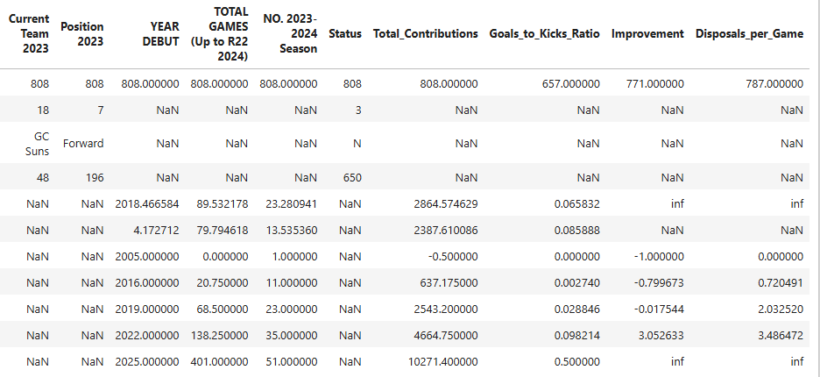
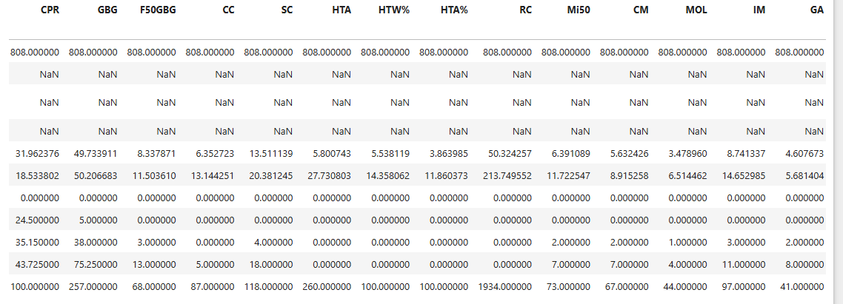

Slide 11
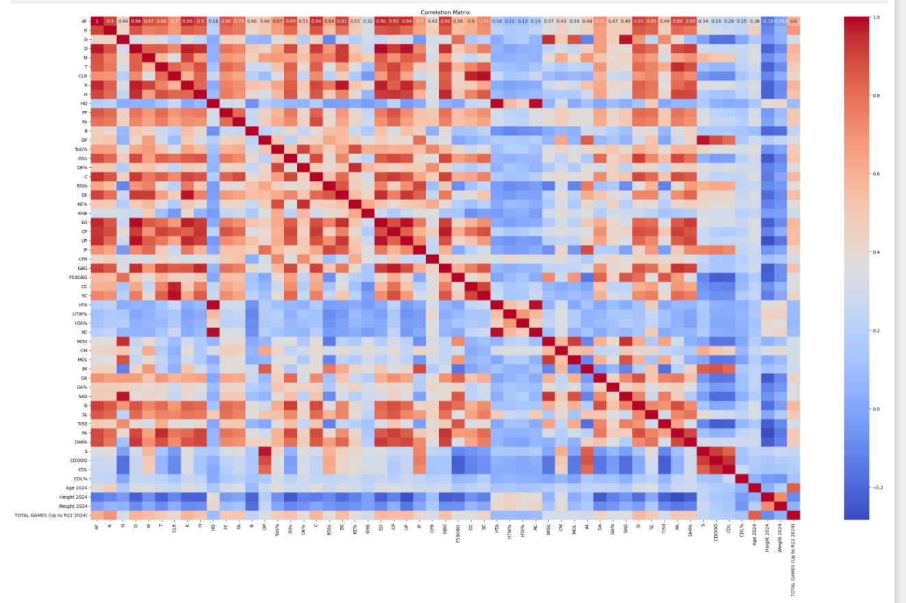
Correlation Matrix

Slide 12
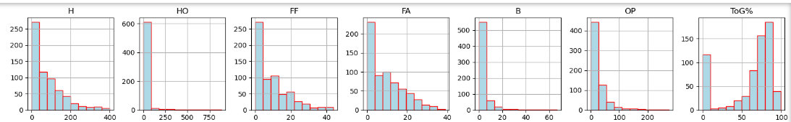
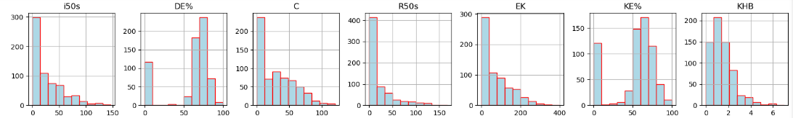
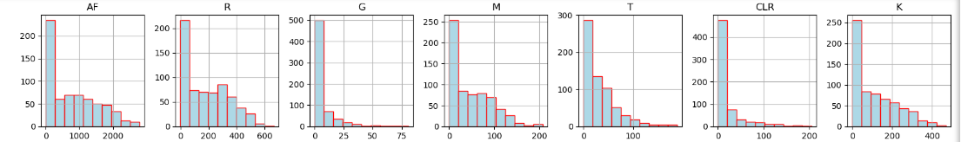
Histogram of the individual features
It appears for all the distributions for each of the individual features are positively skewed. Meaning that the data the mean and median values will be greater than the mode. Along the x-axis represent the bins (values) of the specific column, where the y-axis represent the total number of counts the data points falls in between.

Slide 13
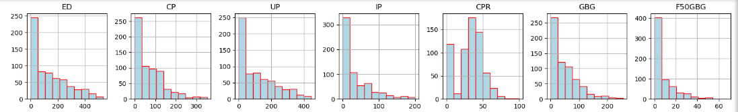
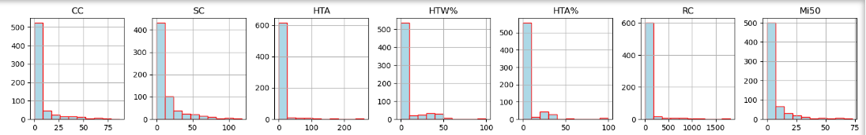
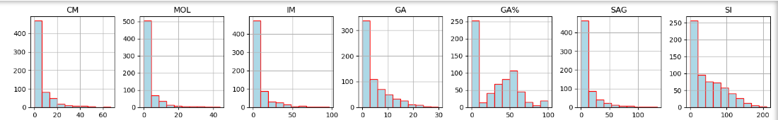
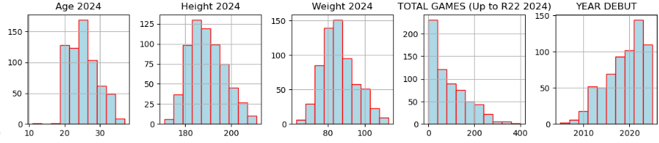

Slide 14
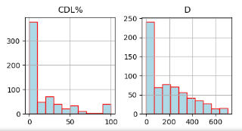
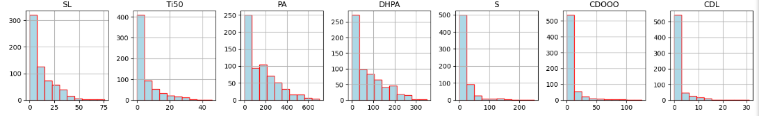

Slide 15
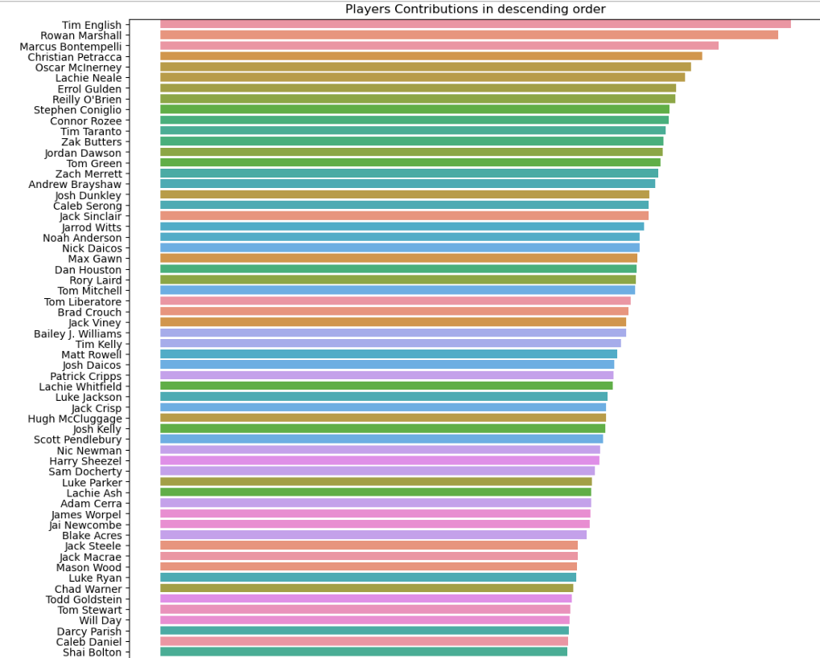
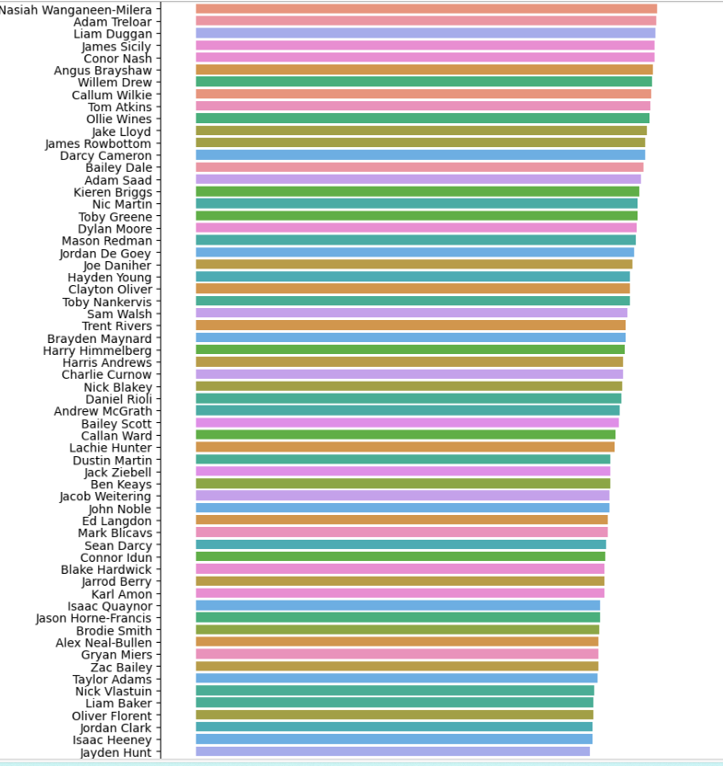
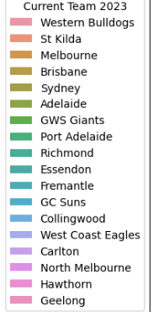
Top Player Contributions

Slide 16
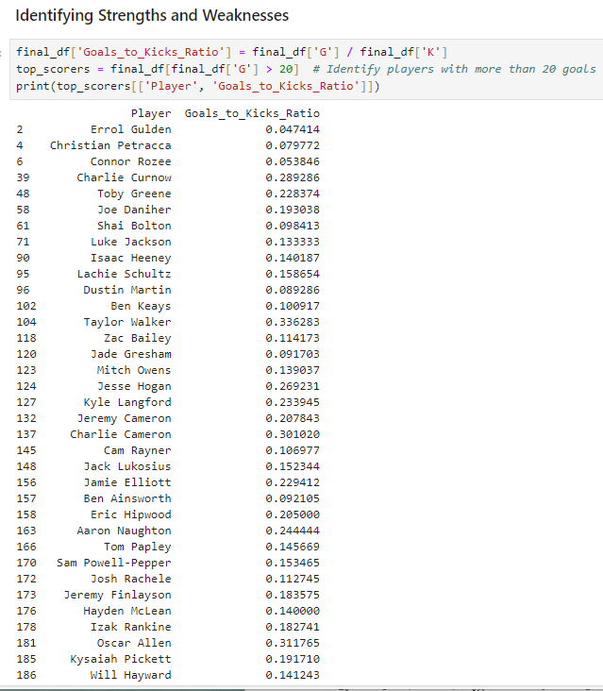
Identifying Strengths and Weakness
Here we analyze specific metrics to highlight areas of strength and improvement.

Slide 17
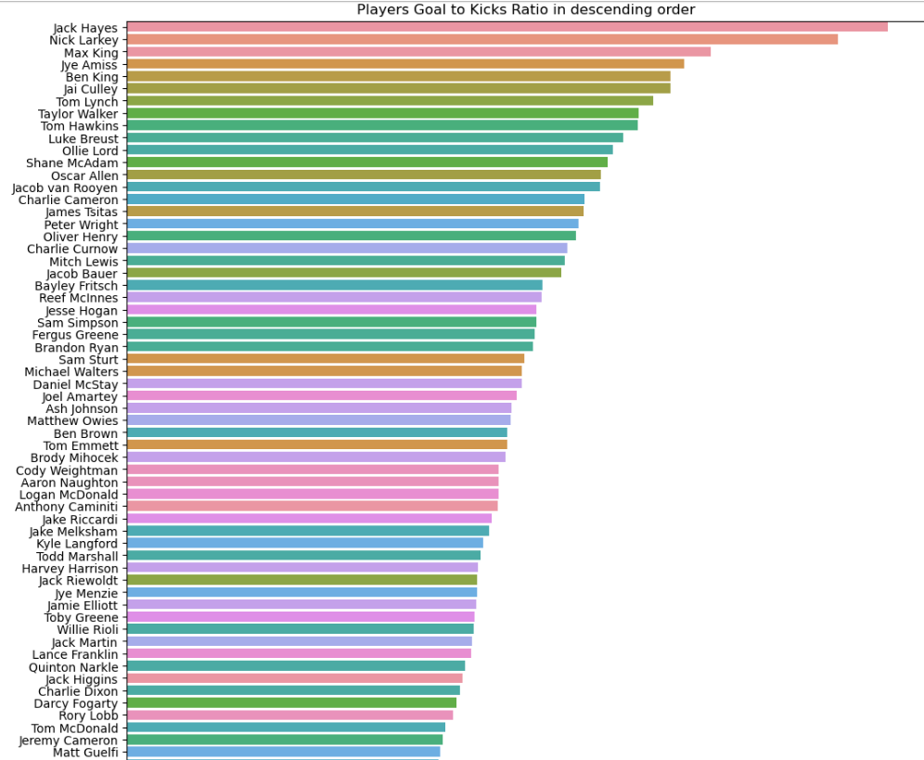
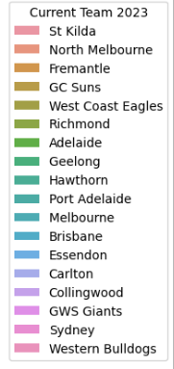
Top Players Goal to Kicks Ratio in Descending Order
NOTE: Not all players are shown here and in future slides

Slide 18
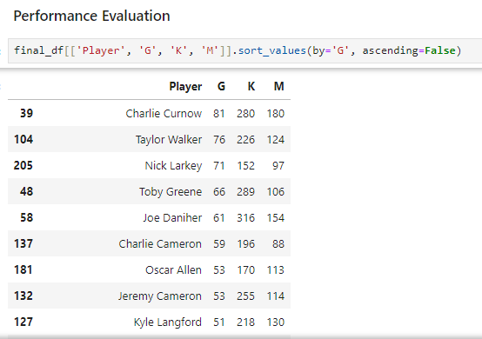
Here were comparing key statistics
across players to determine who is performing well.

Slide 19
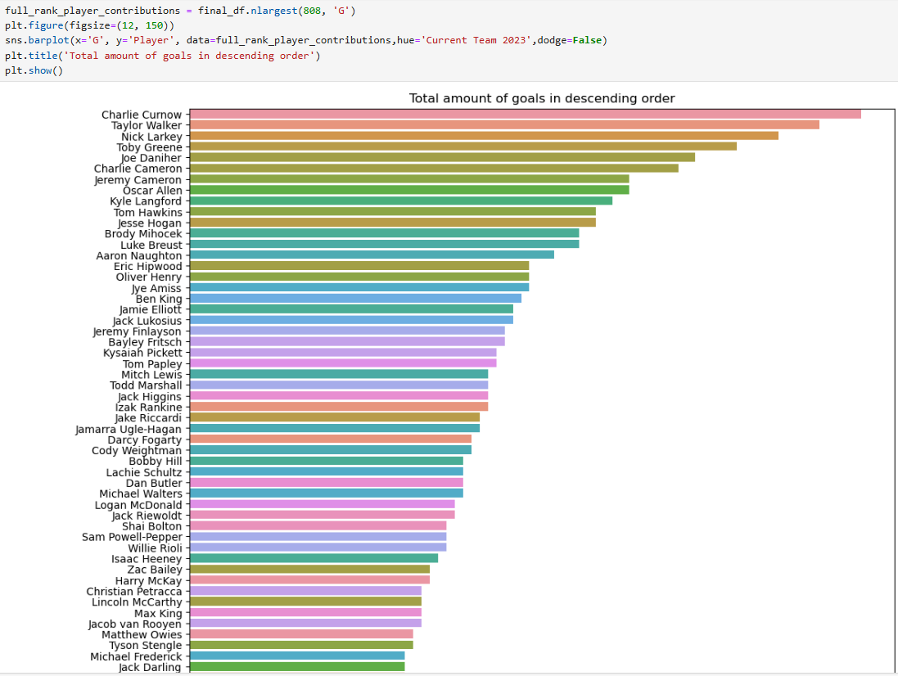
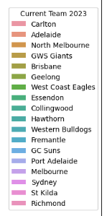
NOTE: Not all players are shown here

Slide 20
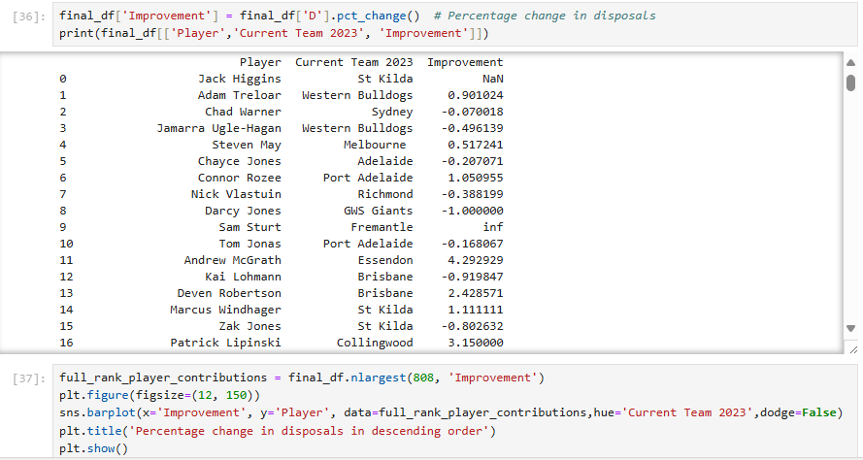
Player Development
Track player progress and set development goals

Slide 21

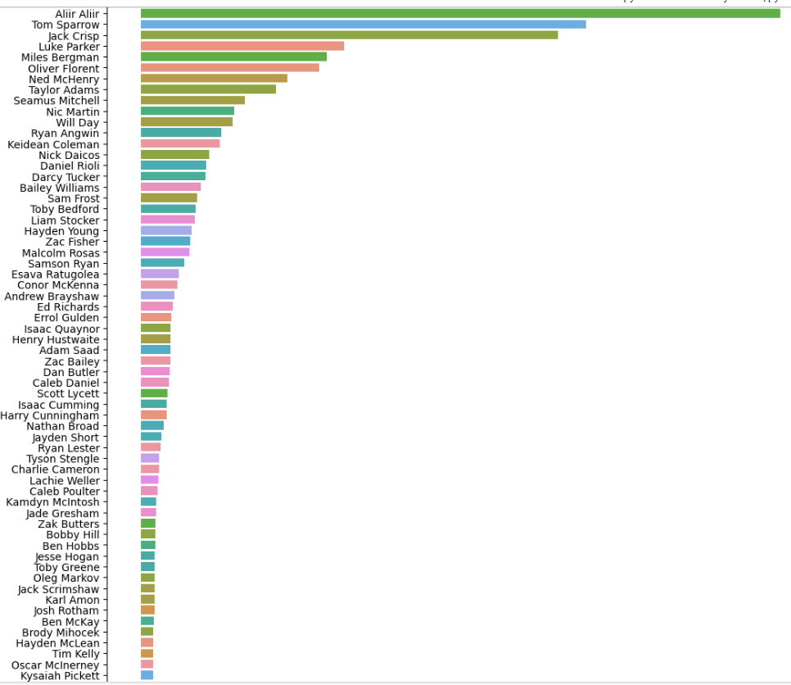
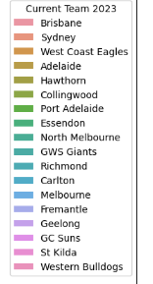

Slide 22
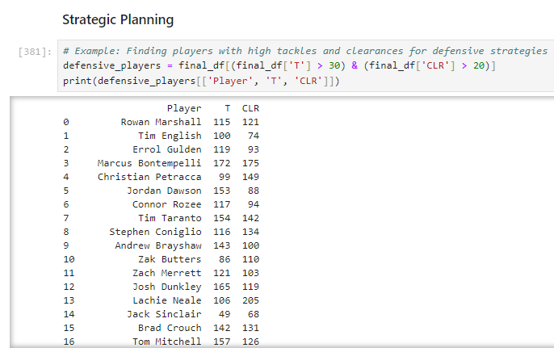
Use data to make strategic decisions for upcoming matches.

Slide 23
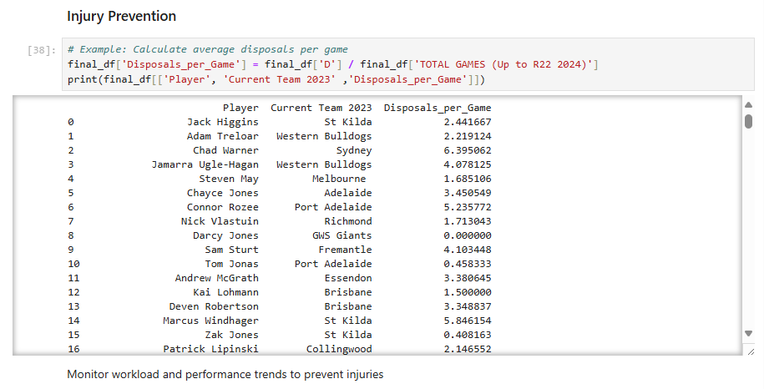

Slide 24
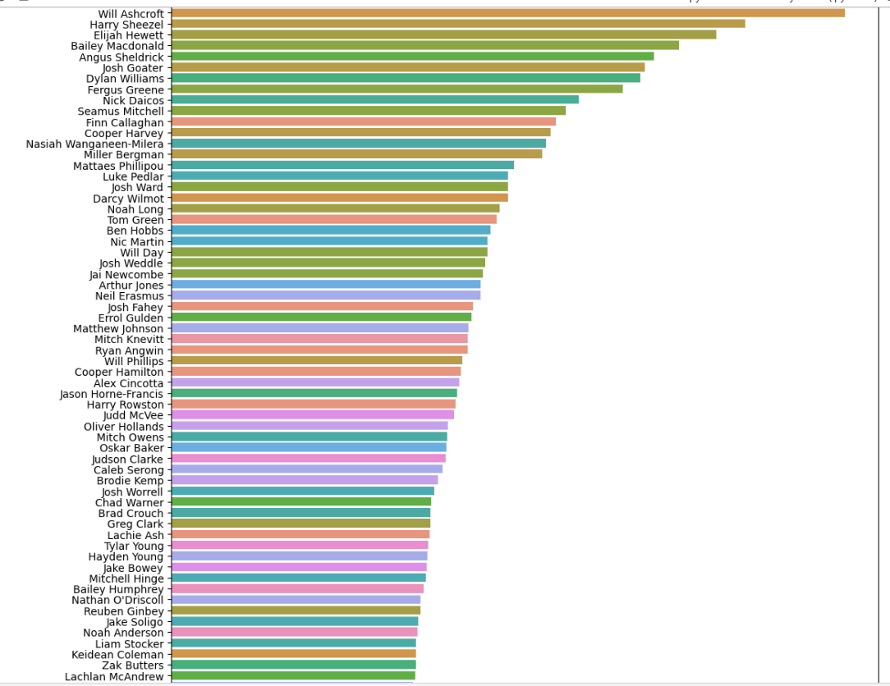
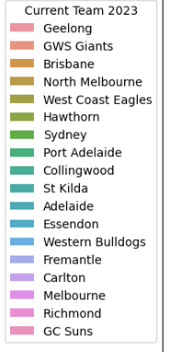
Disposals per Game in descending order

Slide 25
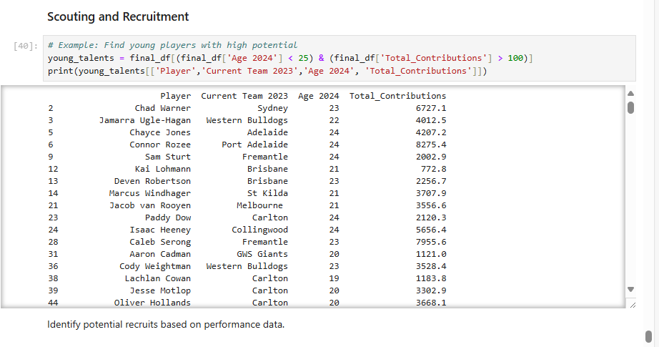

Slide 26
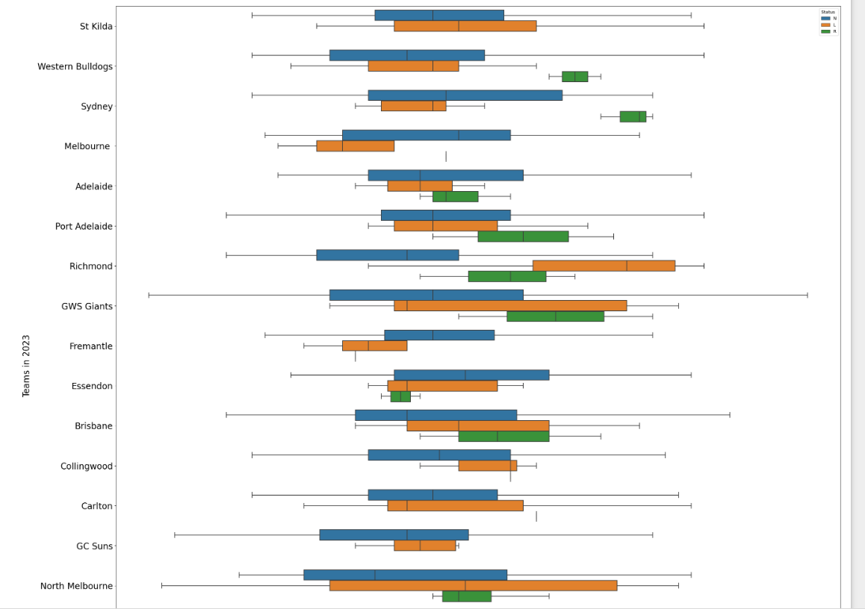
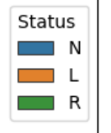
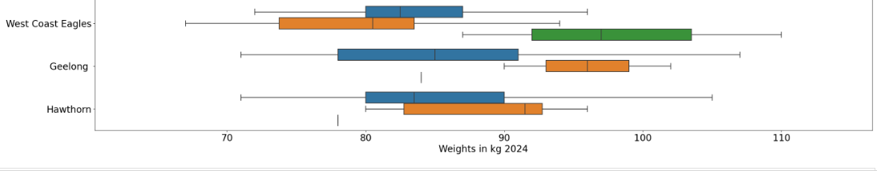
Further Analysis
Box Plot of Weights for each team based on Status
NOTE: Weights and Heights metrics may change over time. Where N are players currently playing in the league in 2023-2024 Season, L Stands for Players Left the club due to reaching their contacts, personal issues, often described as “free agents”, and R represents retiring players.

Slide 27
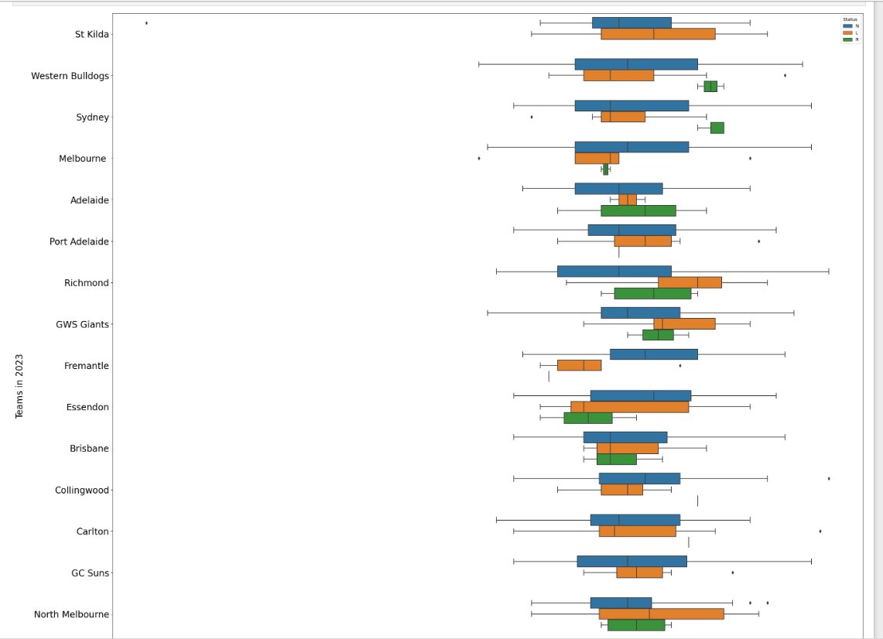
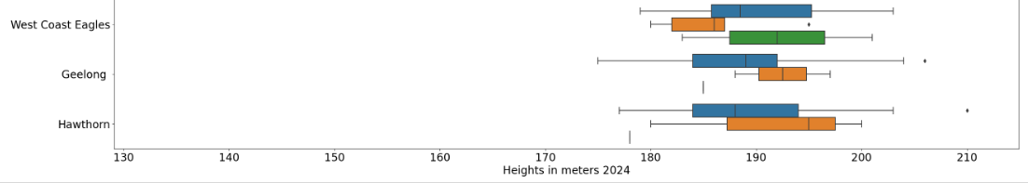
Box Plot of Heights for each team based on Status

Slide 28
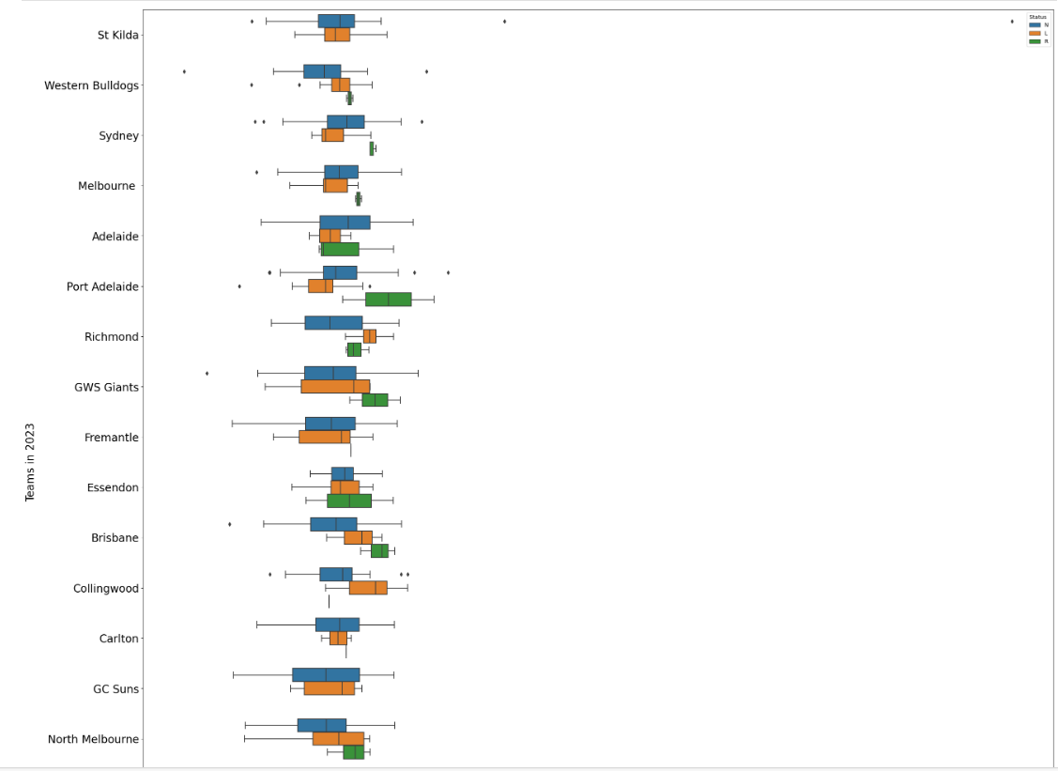
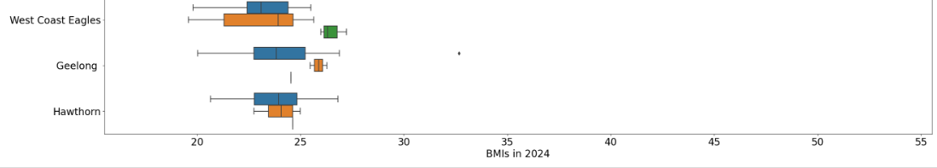
Box Plot of BMIs for each team based on Status

Slide 29

Predicting Fantasy Points

Slide 30
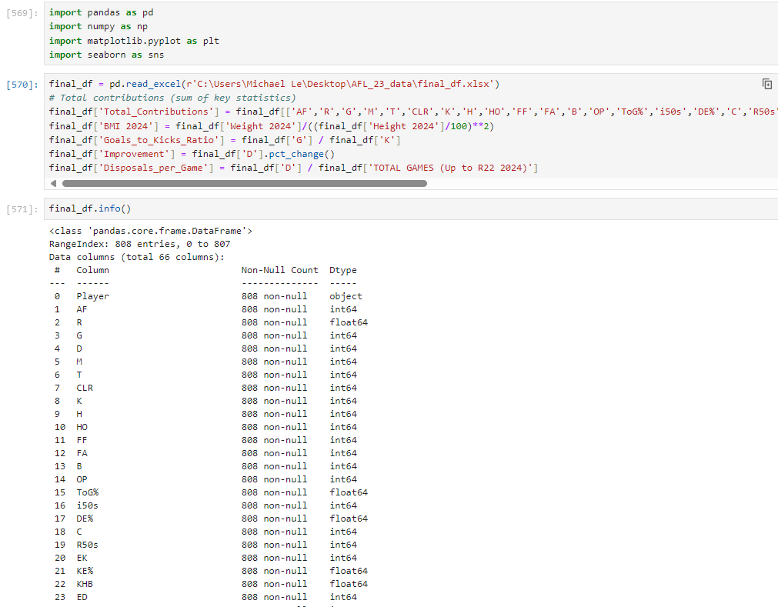
Applying Feature
Engineering

Slide 31
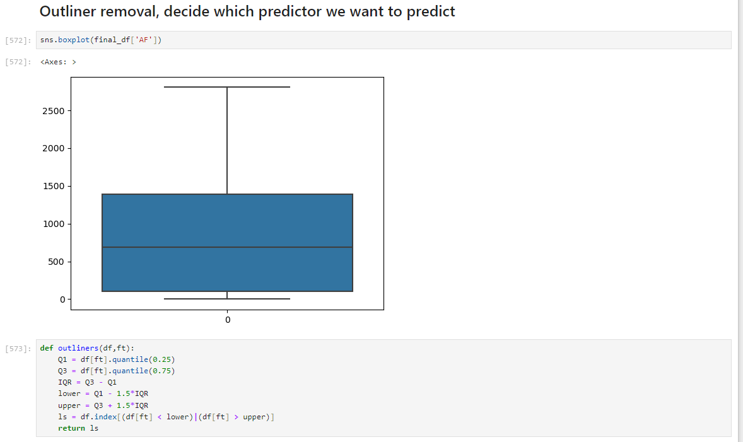
It is important to remove any outliers and further clean, format any remaining in our full dataset to
avoid potential errors, reducing noise, variances,
or bias. In which it can help improve our accuracy in terms of our Machine Learning Models.

Slide 32
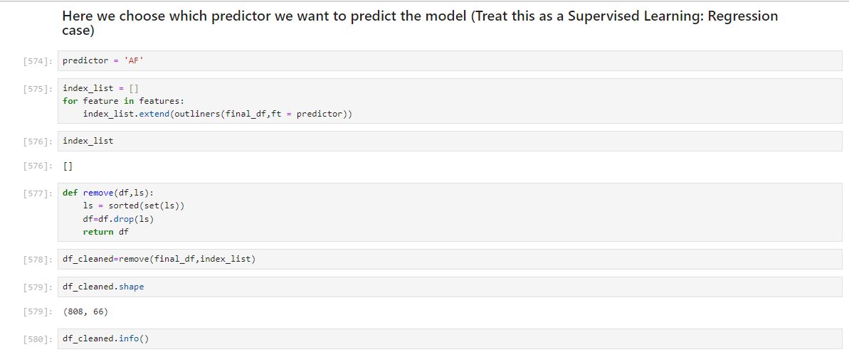

Slide 33

One-hot Encoding
One-hot encoding is a method use to
Characterised from categorical data by numeric vectors without any false
relationships between them. In which it can easily fit into various Machine Learning Models.

Slide 34


The Train-Test Split is a technique
In Machine Learning where the full dataset
Is split into two subsets: The Training set and
Testing Set is used from the full dataset. Later we split into three subsets for the training, testing and validation from the Training dataset, to ensure that the data doesn’t under or overfit the model.

Slide 35

Apply normalization
One reason this is important is because the variables are multiplied by the model weights. So that the scale of the outputs and the scale of the gradients are affected by the scale of the inputs.
Although a model might converge without normalization, normalization makes training much more stable.

Slide 36


Slide 37


Slide 38

Compare which model is the best fit

Slide 39


Slide 40
Conclusion
The main goal of AFL player performance data analysis is to provide actionable insights for various stakeholders, including coaches, players, analysts, fans, and recruiters. These insights drive performance improvement, strategic planning, and fan engagement, ultimately contributing to the success and enjoyment of Australian Rules Football. Some suggestions to improve further analysis such as adding allocation for each of the players teams during the data collection phase. This achieves reducing the number of injuries occurring and improve potential recruits based on performance and historical data. Thus, reducing the number of mistakes and human errors to provide better insights to make decision making more effective.

Slide 41
Further Information
I have applied using data analysis on the AFL 2023 Player Performance datasets based on the link,
https://www.afl.com.au/stats/leaders?category=Key+Stats&seasonId=62&roundId=-1&roundNumber=0&sortColumn=dreamTeamPoints&sortDirection=descending&positions=All&teams=All&benchmarking=false&dataType=totals&playerOneId=null&playerTwoId=null
I have uploaded the datasets uploaded to Kaggle
AFL 2023 Player Performance (kaggle.com)

